Slide 1
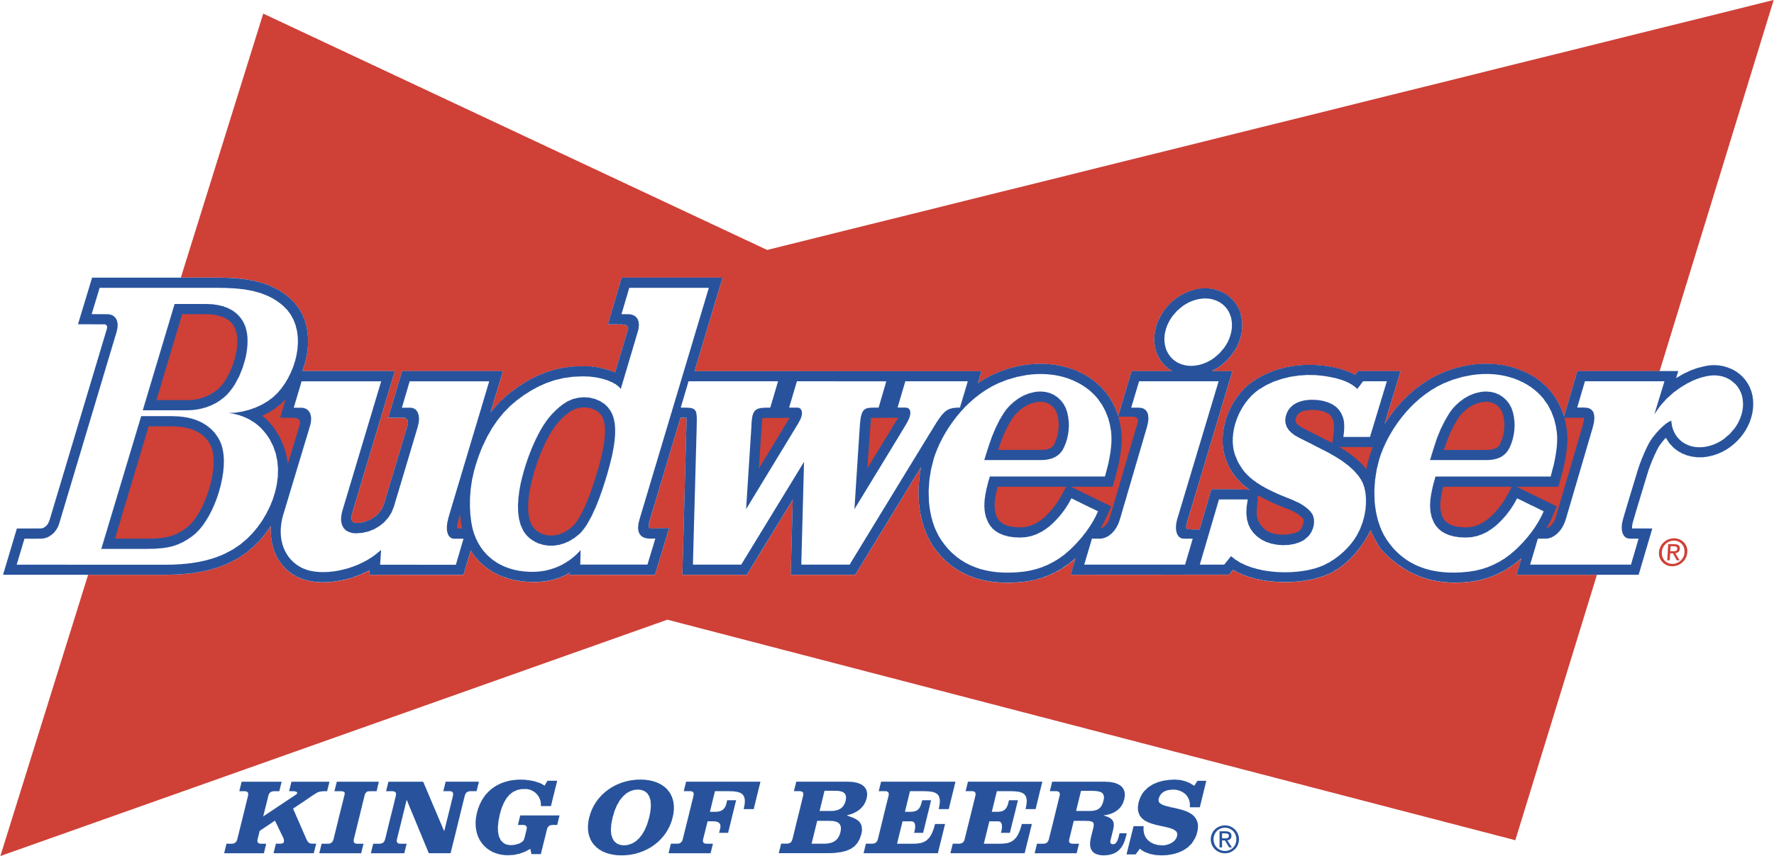
Beers/Breweries EDA Unit 8 Case Study 1
Kosi Okeke
Jaren Shead

Slide 2
Agenda – What to Expect
Breweries per State
Dealing w/ Missing Values in the dataset.
Median ABVs & IBUs by State
The states containing the Maximum ABV & IBU
Breakdown of the ABV variable
Analyzing the relationship between ABV and IBU
KNN Investigation
Exploring the distribution of ABV and IBU across different beer styles
Notes:
Here is the Agenda and what to a expect
We’ll be touching on a wide variety of topics in our analysis

Slide 3
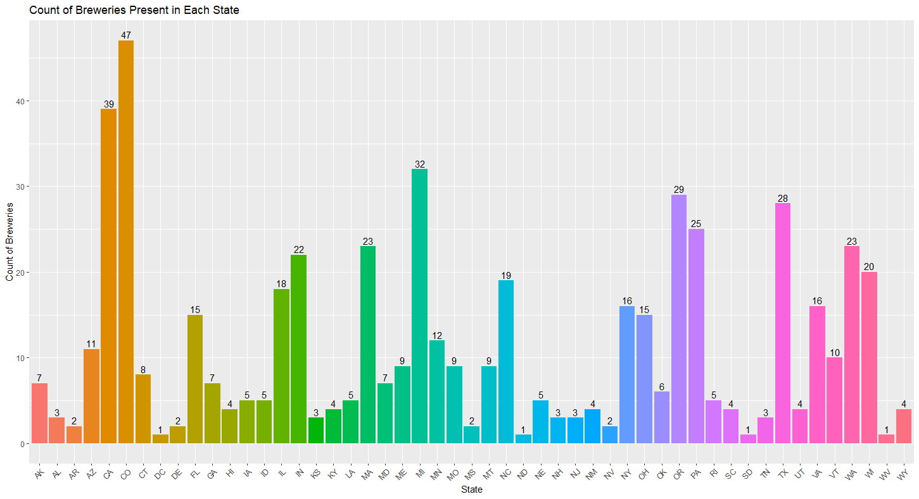
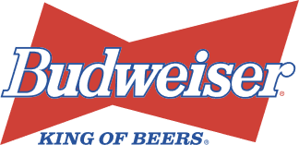
Breweries Present in Each State
Colorado has the most breweries with 47.
California is second with 39.
Michigan is third with 32.
Notes:
Here, to investigate the amount of breweries present in each state we created this simple bar chart.
As you can see, there is a wide range of breweries across all the states.
Some important ones to note are

Slide 4
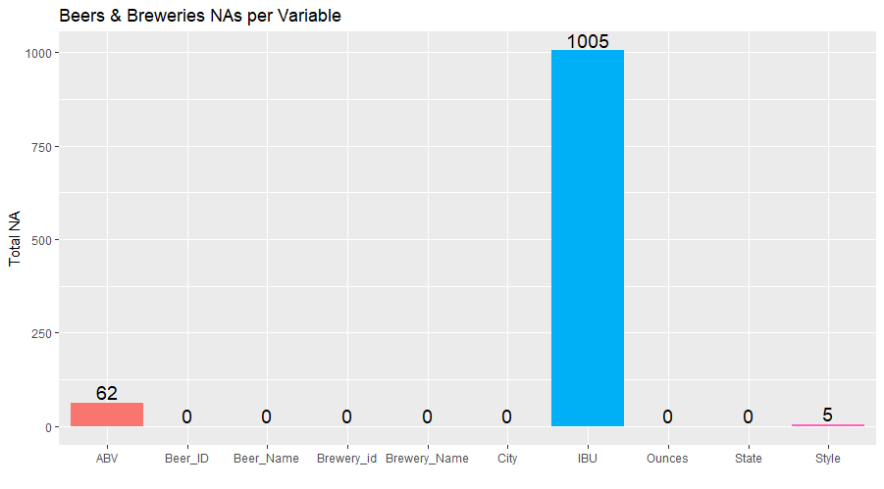

Addressing the Missing Values
To the right is a count of NA's by column.
The data seems to be a mixture of:
MAR ("ABV" column, "Style" column, majority of the "IBU" column).
NMAR (Certain styles of beverage had only missing values i.e. "Cider").
Notes:
The data seems to be a mixture of MAR and NMAR
To get rid of the NA's we use a measure of center (median) and impute. In both instances we take the mean of the ABV and IBU for each style of beverage, then replace the NA value in the ABV column based on the Style of beverage it is. This takes care of the 62 NA's for "ABV" column.
We do the same for the IBU column and notice our NA's go from 1005 to 52.
The remaining NA's are these Styles we called out (i.e. "Cider) that had no values to pull a mean from. Since there are no values to pull from, we can filter out these rows completely bringing our NA's to 0 for the IBU column.
Lastly, to address the NA's under "Style" we took the mode (another measure of center) and replaced the five NA's with the most popular Style.

Slide 5
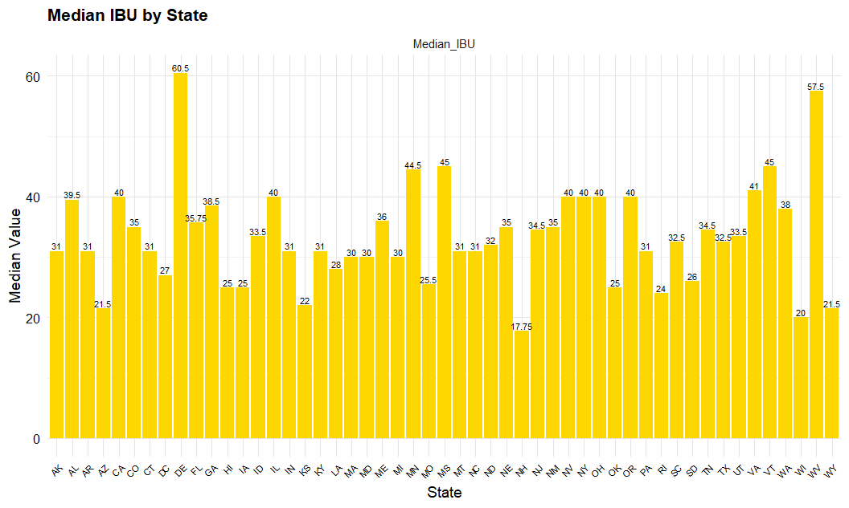
Median ABV and IBU Comparison
Delaware leads in median IBU at 60.5
Notes:
Delaware leads in median IBU at 60.5

Slide 6
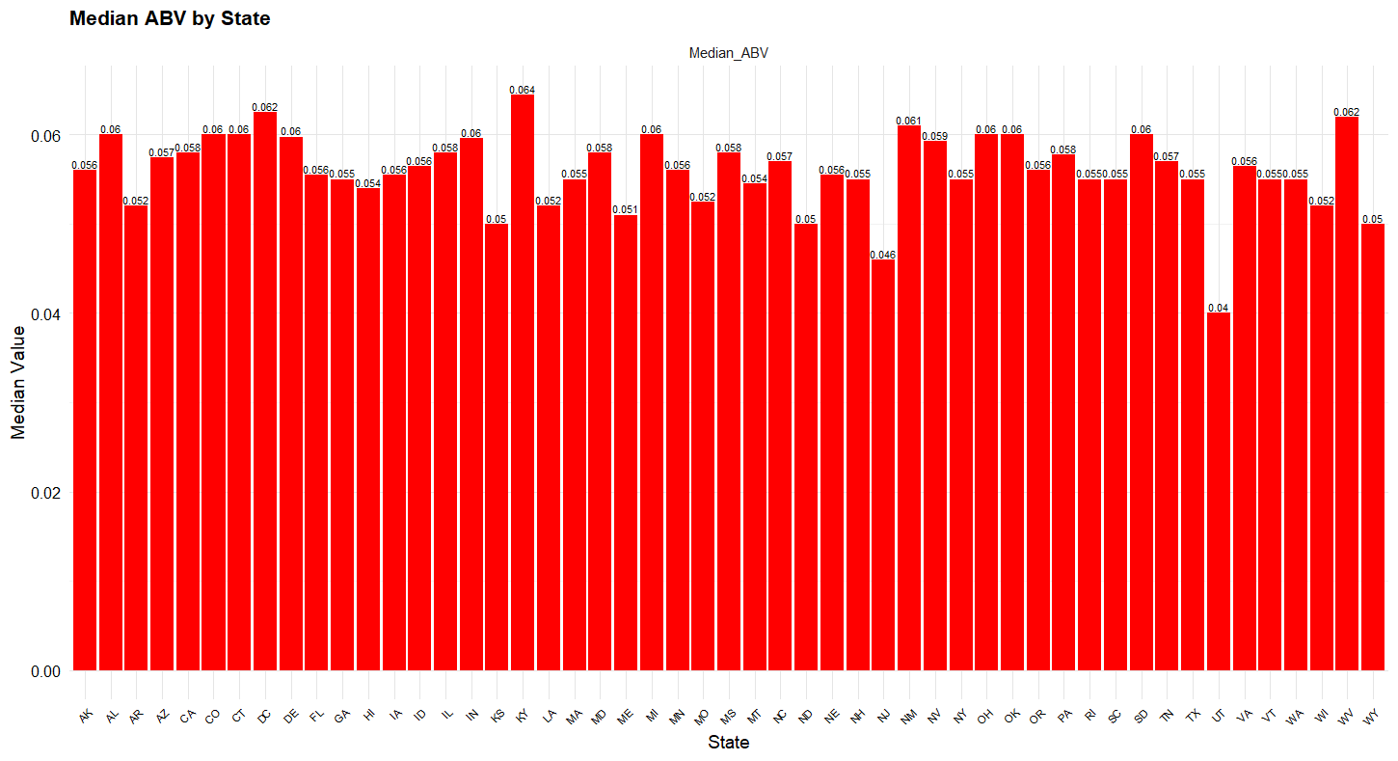
Median ABV and IBU Comparison
Kentucky leads in median ABV at 6.4%
Notes:
Kentucky leads in median ABV at 6.4%

Slide 7
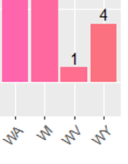
Median ABV and IBU Comparison
West Virginia is in the top two for both ABV and IBU…
Notes:
West Virginia is in the top two for both ABV and IBU, but there was only 1 brewery recorded in West Virginia which could be skewing those numbers due to the small sample size

Slide 8
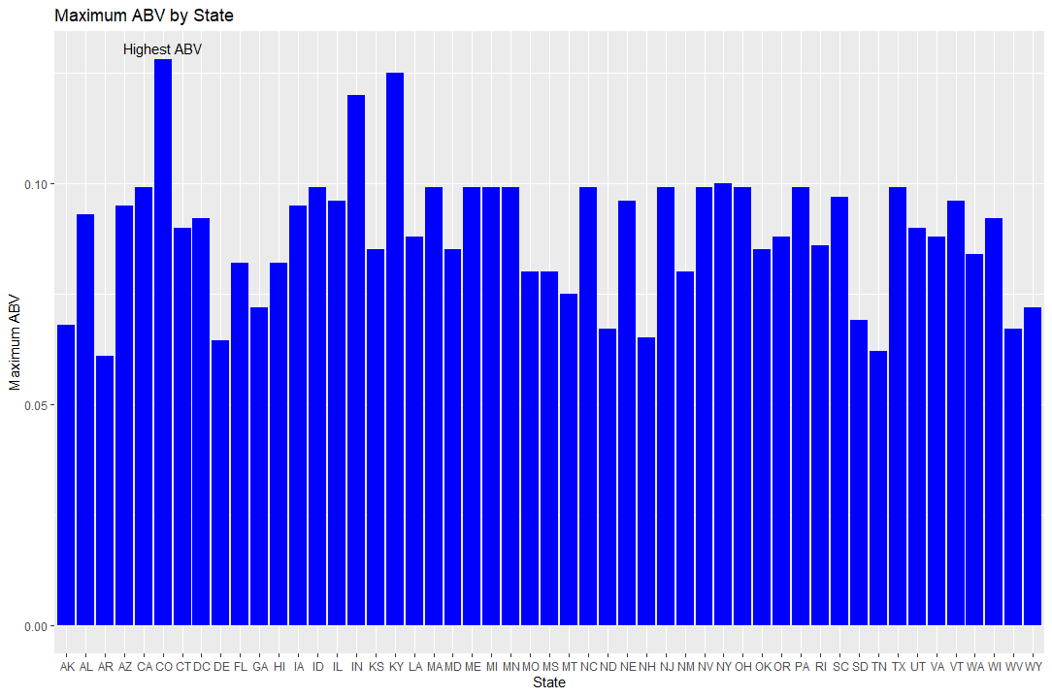
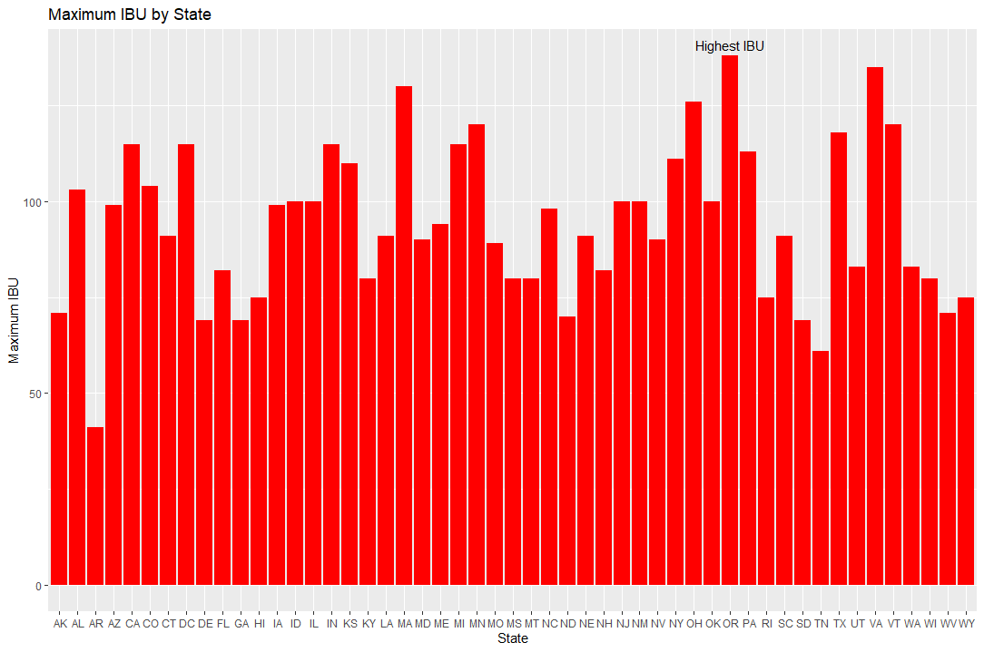
Max ABV and Most Bitter Beer
Max ABV = 0.128
State: Colorado
Max IBU = 138
State: Oregon
Notes:
We see that the max ABV is 0.128 and this is found in the state of Colorado
While the max IBU is 138 found in the state of Oregon.

Slide 9
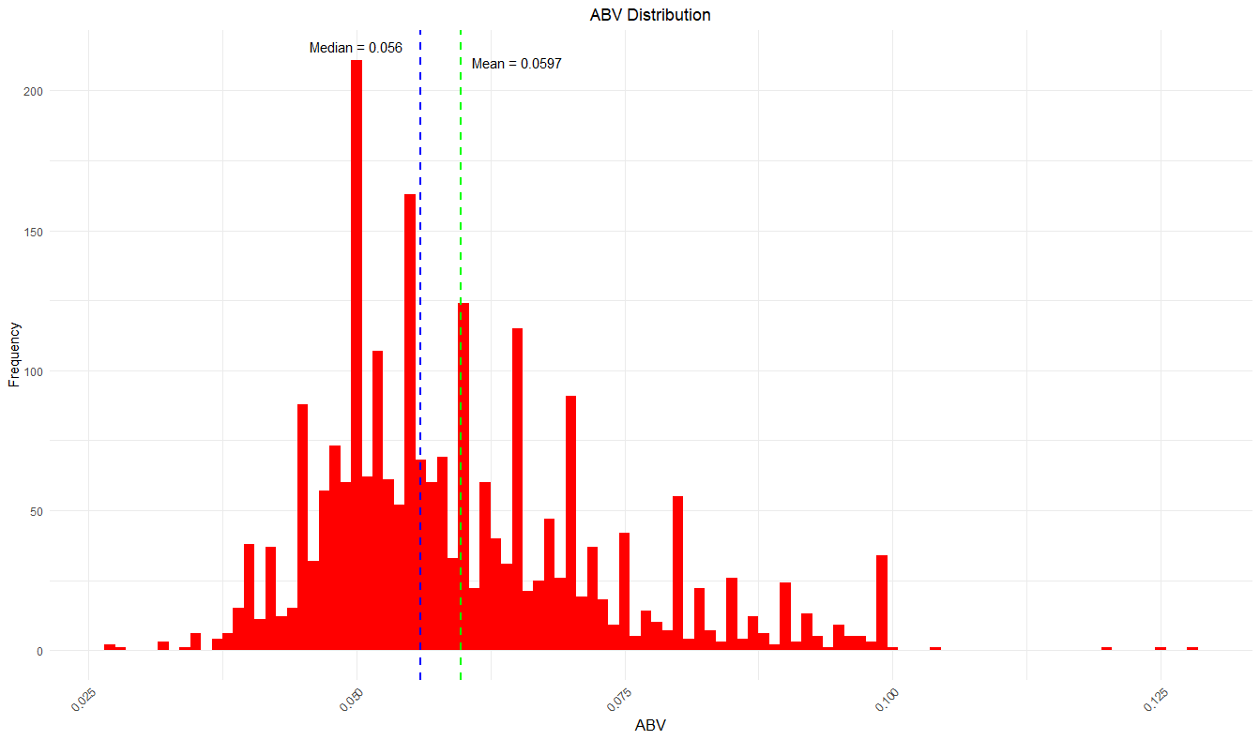
ABV Breakdown
Mean = .0597 = 5.97%
Median = .0560 = 5.6%
Min = .0270 = 2.7%
Max = .1280 = 12.8%
Standard Deviation = .0134 = 1.34%
Notes:
Comment on the summary statistics and distribution of the ABV variable.
#just by examining the chart, we can see what looks to be some right skewness
# average of about 6%
# ranges from 2.7 to 12.8%
# standard deviation of about .0134 or 1.34% ... considering the scale of the variable, that seems somewhat large
# looks to be heavily influenced by the outliers
# looking at the chart, the data is right skewed

Slide 10
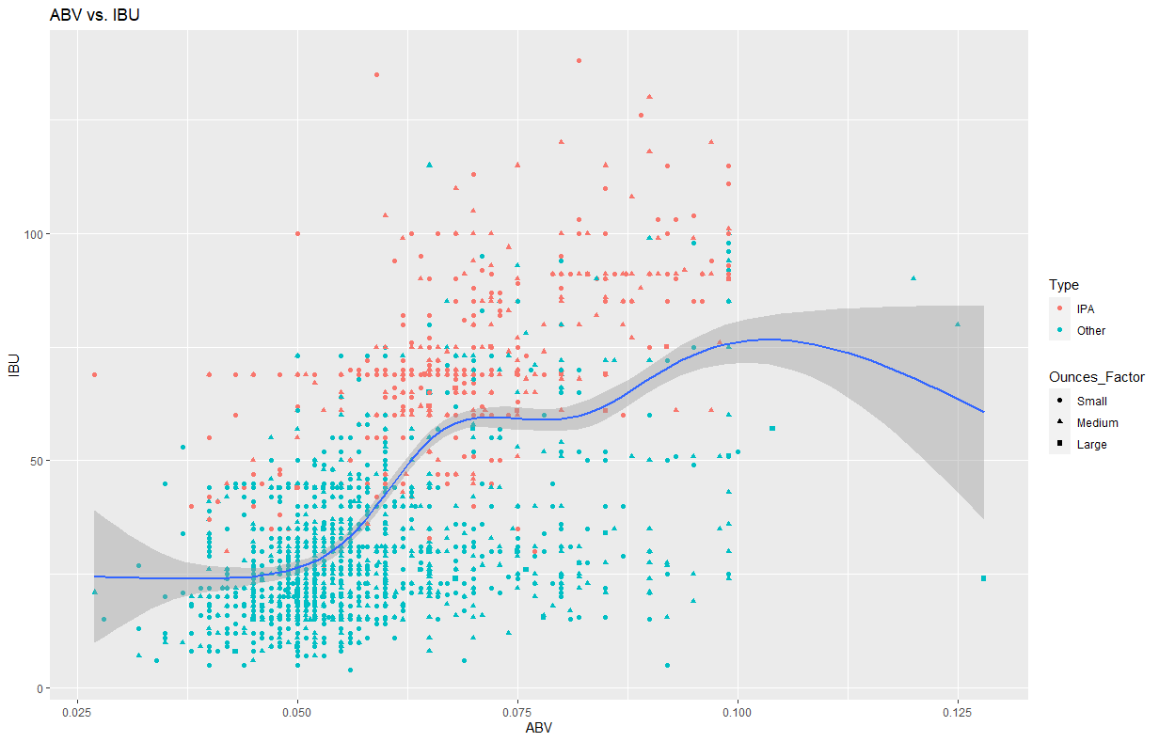
ABV vs. IBU
Scatterplot of Relationship:
Color = IPA or Other type of ale
Shape = Size (in fl.oz)
Notes:
Generally, an increase in ABV is associated with an increase in IBU or vice versa. This makes sense because the more bitter beverages on average are IPA's that have a higher ABV. HOWEVER, we can't generalize and say that this is always the case as there are some beverages that have a high ABV but a very low IBU. There could be other variables as well effecting the relationship between ABV & IBU.

Slide 11
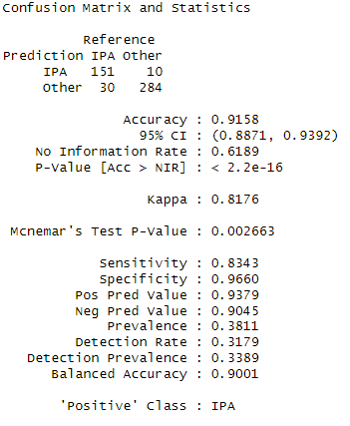
KNN Investigation
Accuracy: 91.58%
Sensitivity: 83.43%
Specificity: 96.60%
T-Test Results…
Notes:
Accuracy (91.58%): This high accuracy suggests that the model is very reliable.
Sensitivity (83.43%): this indicates that 83.43% of actual IPAs were correctly identified by the model.
Specificity (96.60%): shows that the model correctly identified 96.60% of non-IPA beers. The specificity and sensitivity suggest that the model can be used as part of quality control to ensure beers are consistent with style standards.
After conducting t tests to see if the differences between ABV and IBU are statistically significant, we revealed that IPAs generally have higher ABV and are more bitter than Pale Ales, highlighting distinct consumer tastes in the beer market.

Slide 12
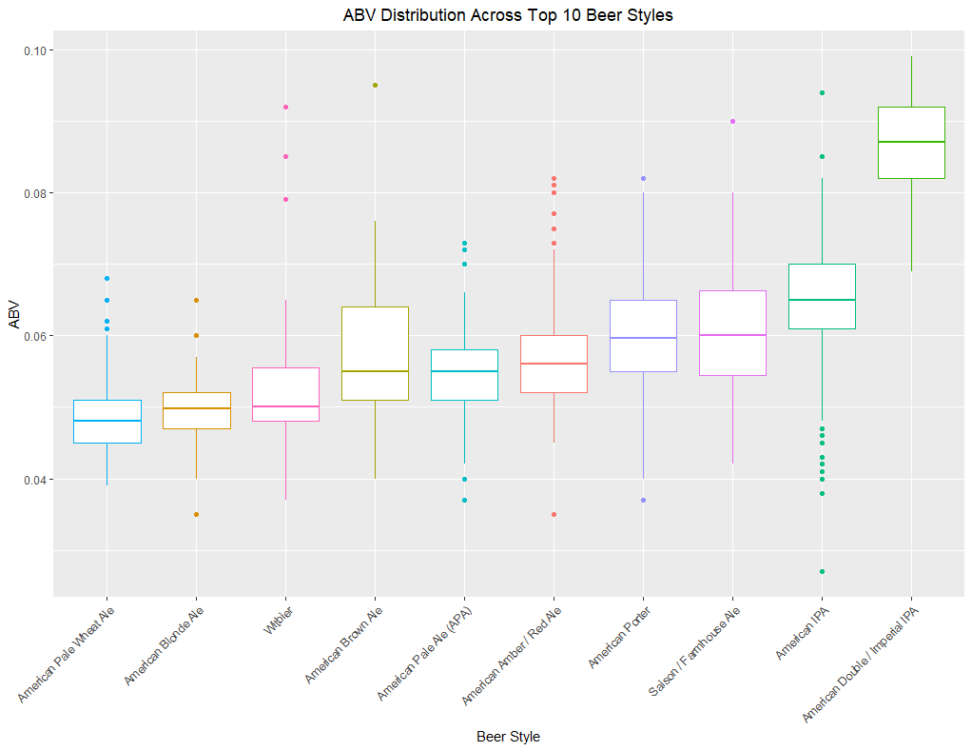
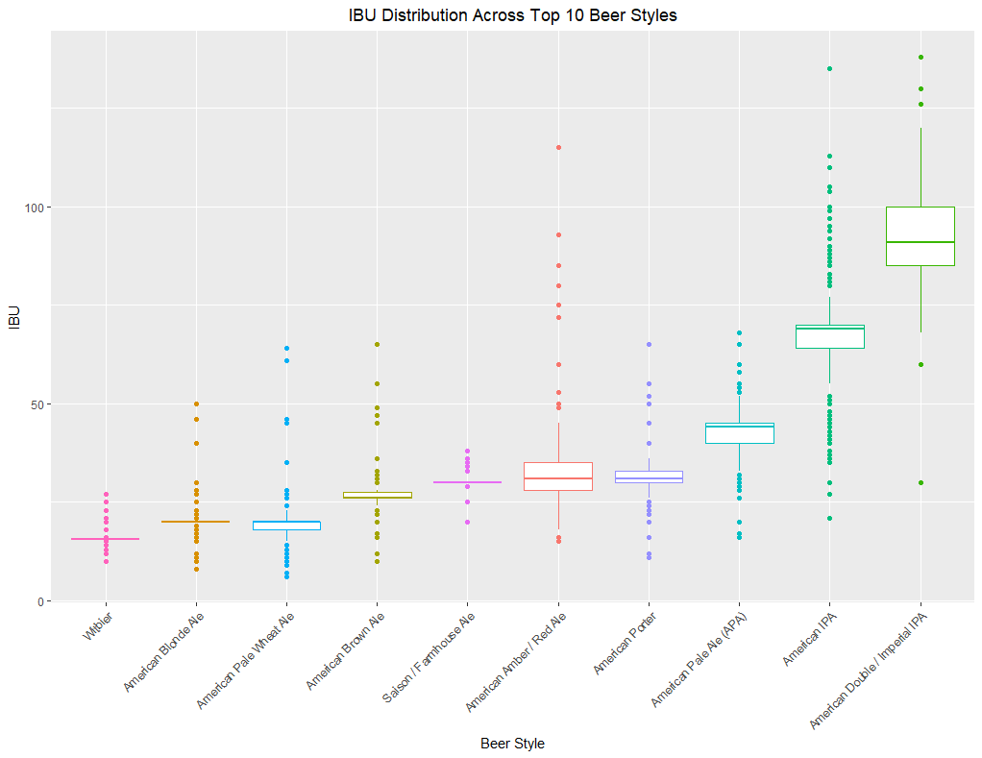
Exploring the Distribution of ABV and IBU Across Different Beer Styles
ABV
IBU
Variety in Strength
Consumer Preferences
Quality Control
Bitterness Variation
Market Dynamics
Marketing Strategy
Notes:
# We decided a compelling area of investigation could involve analyzing beer styles' popularity and market trends
ABV:
Variety in Strength: Top beer styles vary widely in alcohol content.
Consumer Preferences: ABV ranges align with consumer preferences for both light and strong beers.
Quality Control: Smaller ABV ranges within a style indicate a consistent product.
IBU:
Bitterness Variation: IPA styles have higher IBUs, showing distinct bitterness.
Market Dynamics: Broad IBU ranges suggest opportunities for product variety.
Marketing Strategy: Different IBUs can target preferences tied to beer bitterness.
In conclusion, High ABV often goes hand-in-hand with high IBU, as seen with American Double/Imperial IPAs, suggesting a balance that craft beer enthusiasts might appreciate.

Slide 13
Thank You!
Contact: kokeke@smu.edu ; jshead@smu.edu
Questions?
Link to Presentation: https://youtu.be/2Mgc8_C71eY?si=7qpE036cY3x7C30u
Notes:
This has been the Budweiser beers and breweries eda. Any questions or comments?

